Slide 1
Essence of Linear Algebra

Slide 2
Vectors
A vector is an object that has both a magnitude and a direction.
The magnitude of a vector is determined by |v| = √(x² + y²).
A vector with no direction or magnitude is called as null vector.
A vector with same direction but different magnitude of unit 1 is unit vector.

Slide 3
Span of a Vector
The span of set of vectors refers to all possible linear combinations that can be formed with the vectors
i.e.,the span of the set of vectors is the set of all vectors that can be expressed as linear combinations of the given vectors

Slide 4
Linear Transformation
A linear transformation is a function that maps vectors from one vector space to another.
It is carried out by a process called matrix multiplication.
It possesses two properties :
Additivity
Homogenity

Slide 5
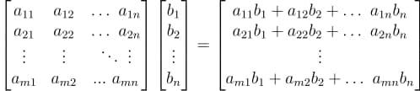
Matrix Multiplication
Matrix multiplication is a fundamental operation in linear algebra where two matrices are combined to produce a third matrix.

Slide 6
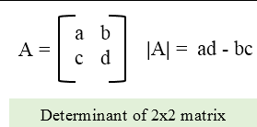
Determinant
The determinant of a square matrix is a scalar value that provides important information about the matrix, such as whether it is invertible and how it scales space.
For an n x n square matrix A , it is denoted as det(A) or |A|.

Slide 7
Dot Product
The dot product (also called the scalar product) is an operation between two vectors that results in a scalar (a single number). It measures how much one vector extends in the direction of another.
It is represented by (for A,B) A.B=|A||B|cos θ

Slide 8
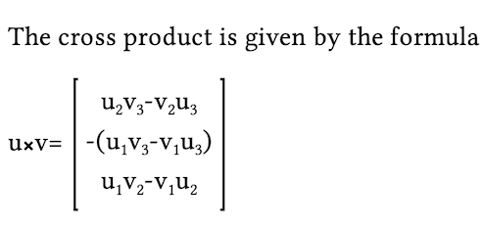
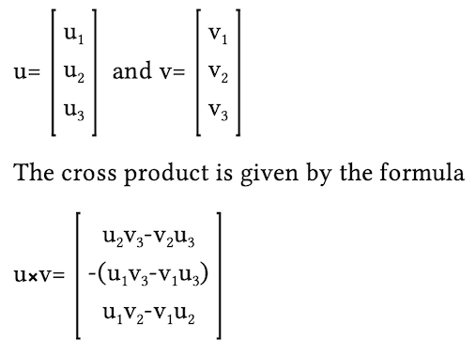
Cross Product
The cross product is an operation between two vectors in 3D space that results in a new vector that is perpendicular to both original vectors.

Slide 9
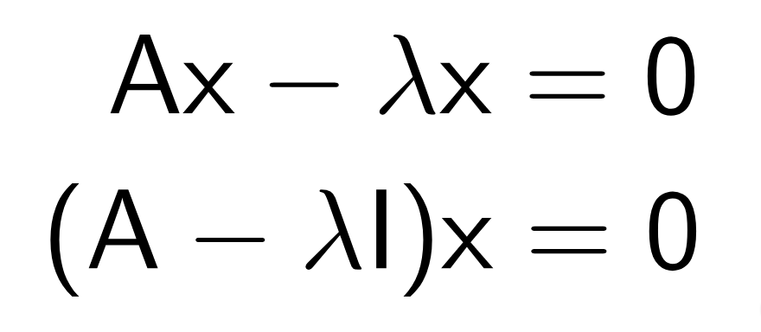
Eigen vectors and values
For a square matrix A, an eigenvector v and its corresponding eigenvalue λ satisfy:
A is n x n matrix ,v is a non-zero vector λ is scalar(eigen value).
The eigen value is basically a number that used for transforming eigen vectors.

Slide 10
Thank
you

